Slide 1
Information Aggregation via Dynamic Routing for Sequence Encoding
2019-03-23
현청천

Slide 2
Reference
https://arxiv.org/pdf/1806.01501v1.pdf
https://github.com/FudanNLP/Capsule4TextClassification
https://jayhey.github.io/deep%20learning/2017/11/28/CapsNet_1/

Slide 3
Introduction
Many successful text encoding methods usually contain three key steps:
(1) converting each word in a text sequence into its embedding;
(2) taking as input the sequence of word embeddings, and computing the context-aware representation for each word with a RNN or CNN;
(3) summarizing the sentence meaning into a fixed-size vector by an aggregation operation.
max (or average) pooling
self-attention
Aggregation: deliver the messages from source nodes to target nodes.
source nodes: outputs of a RNN or CNN encoding layer
target nodes: one or several fixed-size encoding vectors to represent the meaning of the text sequence
standard dynamic routing(capsule network): source node decides what and how many messages are sent to different target nodes
reversed dynamic routing: target node decides what and how many messages may be received from different source nodes.

Slide 4

Background general sequence encoding for text classification
Embedding Layer
Input Word: $S=[w_{1}, w_{2},…,w_{L}]$
Embedding Vector: $X=[x_{1}, x_{2},…,x_{L}]$
Encoding Layer (BiLSTM)
Forward: $h_{t}^{f}=LSTM\left(h_{t−1}^{f},x_{t}\right)$
Backward: $h_{t}^{b}=LSTM(h_{t+1}^{b},x_{t})$
Phrase level encoding: $h_{t}=[h_{t}^{f};h_{t}^{b}]$
BiLSTM output: $H=[h_{1}, h_{2},…,h_{L}]$
Aggregation Layer
Max or Average Pooling
Max Pooling: $e^{max}=max⁡(\left[h_{1},h_{2},…,h_{L}\right])$
Avg Pooling: $e^{avg}=\frac{1}{L}\sum_{i=1}^{L}{h_{i}}$
Self-Attention
$u_{i}=q^{T∗}h_{i}$
$a_{i}=\frac{exp⁡(u_{i})}{\sum_{k}{exp⁡(u_{k})}}$
$e^{attn}=\sum_{i=1}^{L}{a_{i}∗h_{i}}$
Prediction Layer
$P\left(∗ | e\right)=softmax(MLP(e))$

Slide 5
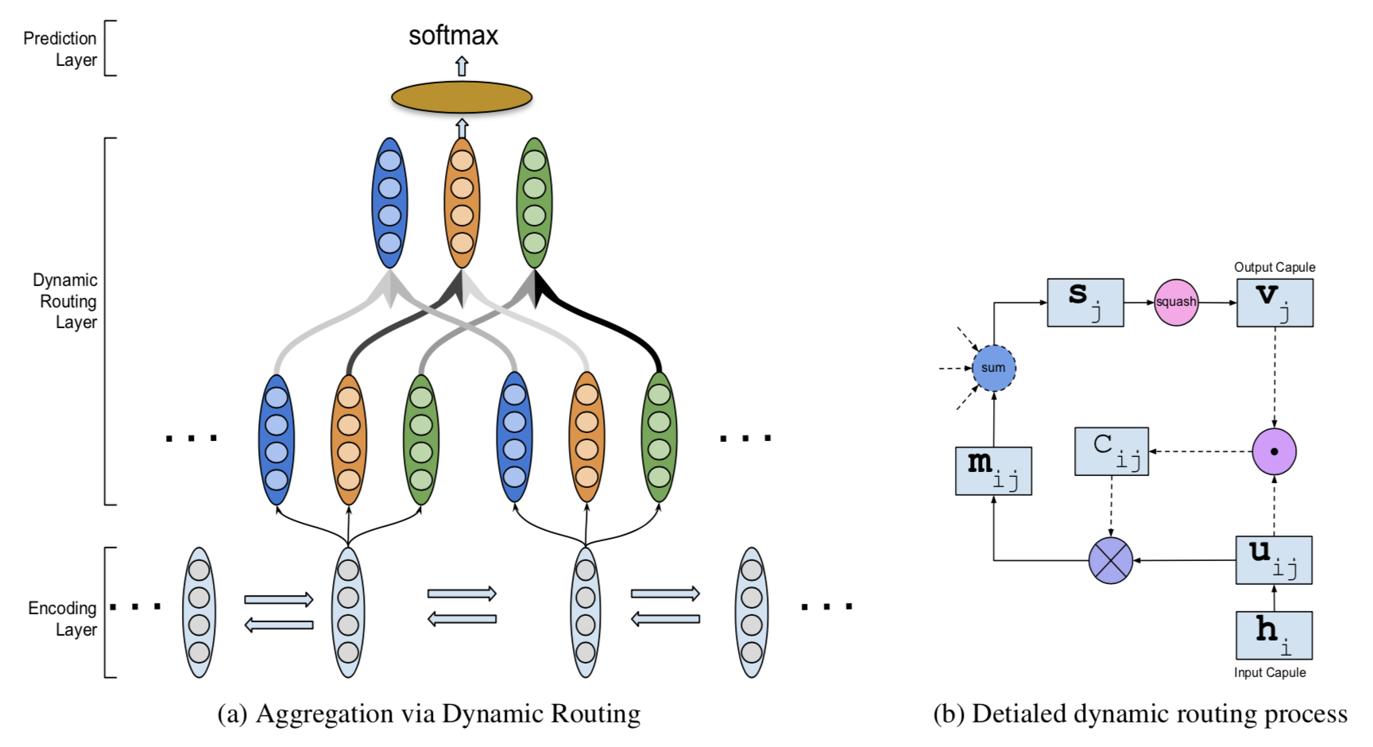
Aggregation via Dynamic Routing (1/3)

Slide 6
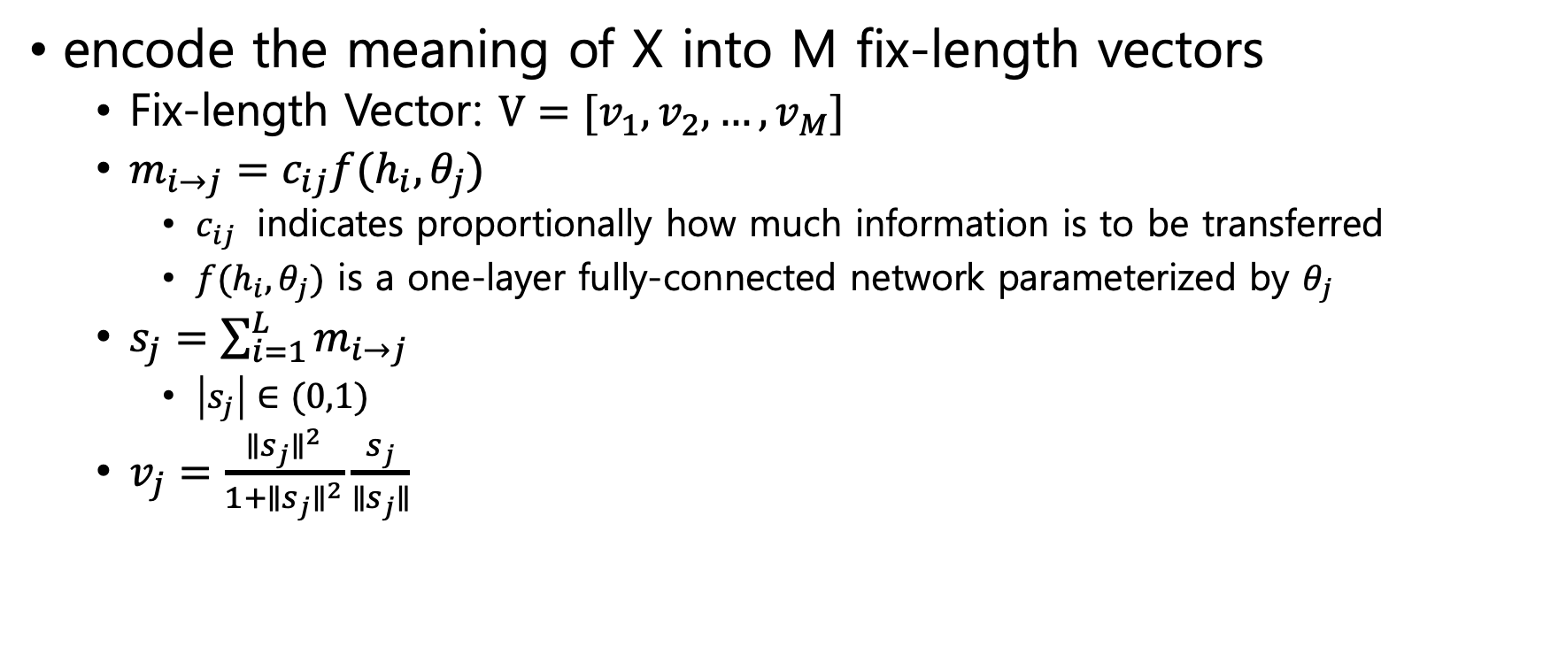
Aggregation via Dynamic Routing (2/3)
encode the meaning of X into M fix-length vectors
Fix-length Vector: $V=[v_{1}, v_{2},…,v_{M}]$
$m_{i→j}=c_{ij}f(h_{i},θ_{j})$
$c_{ij}$ indicates proportionally how much information is to be transferred
$f(h_{i},θ_{j})$ is a one-layer fully-connected network parameterized by $θ_{j}$
$s_{j}=\sum_{i=1}^{L}{m_{i→j}}$
$\left|s_{j}\right|∈(0,1)$
$v_{j}=\frac{∥s_{j}∥^{2}}{1+∥s_{j}∥^{2}}\frac{s_{j}}{∥s_{j}∥}$

Slide 7
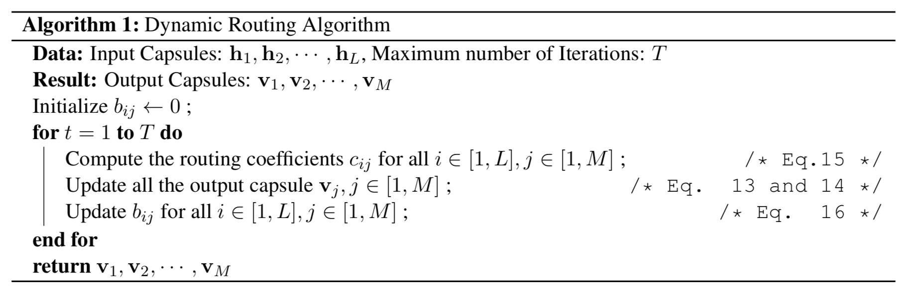
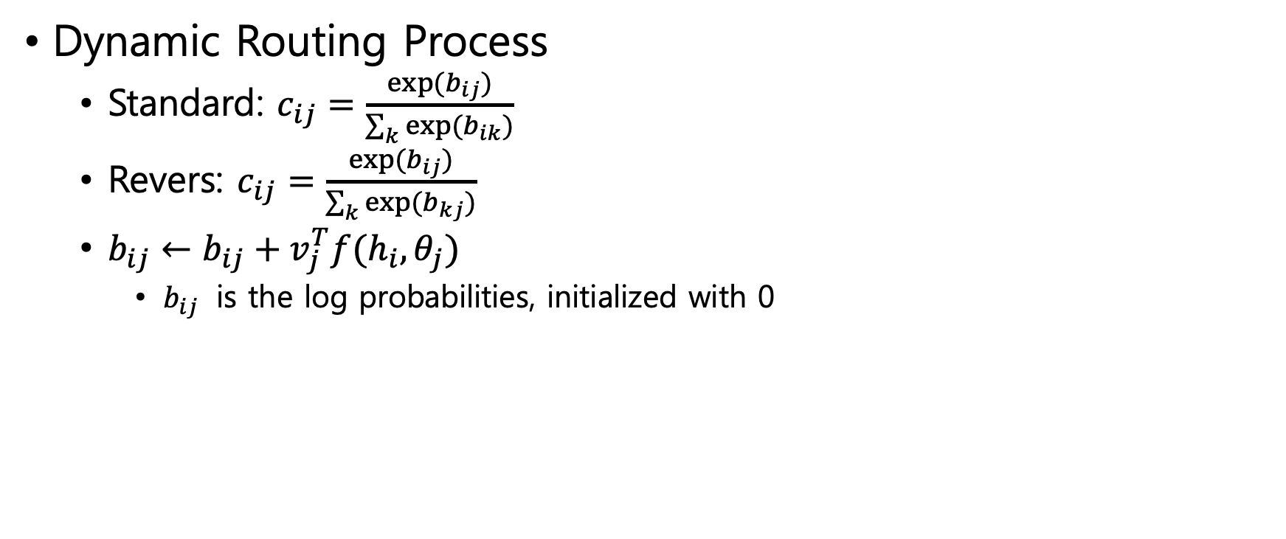
Aggregation via Dynamic Routing (3/3)
Dynamic Routing Process
Standard: $c_{ij}=\frac{exp⁡(b_{ij})}{\sum_{k}{exp⁡(b_{ik})}}$
Revers: $c_{ij}=\frac{exp⁡(b_{ij})}{\sum_{k}{exp⁡(b_{kj})}}$
$b_{ij}←b_{ij}+v_{j}^{T}f(h_{i},θ_{j})$
$b_{ij}$ is the log probabilities, initialized with 0

Slide 8
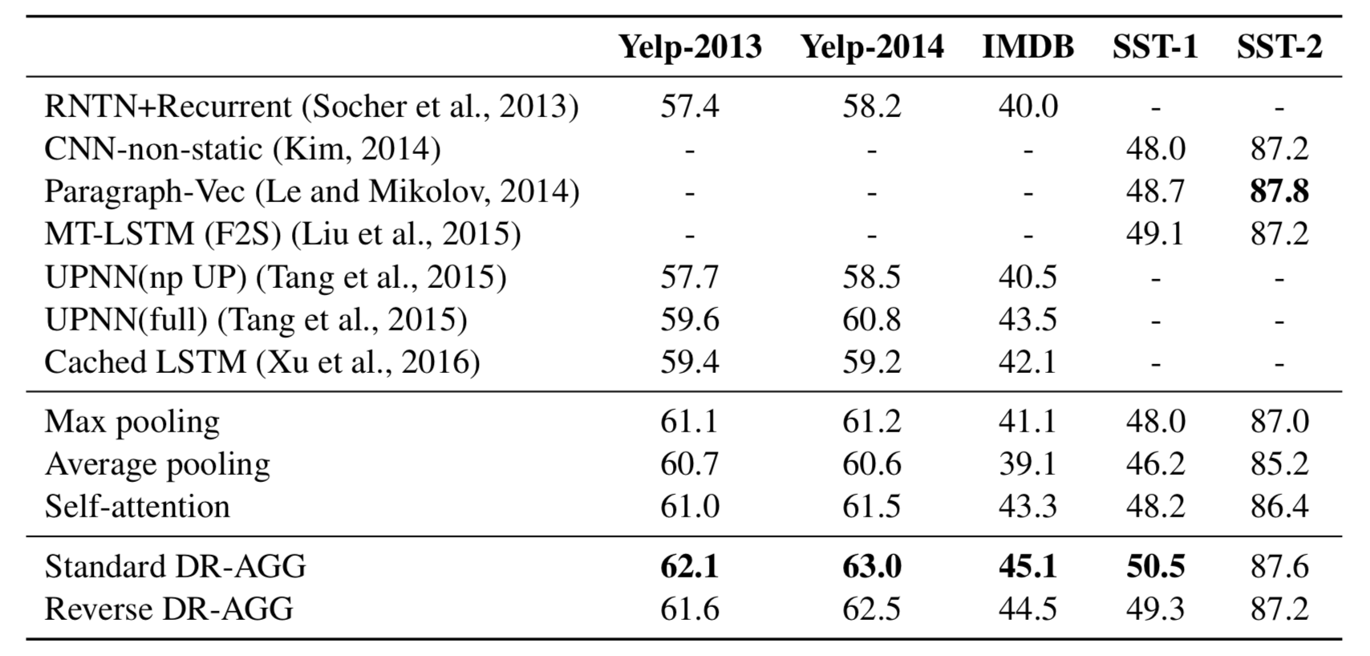
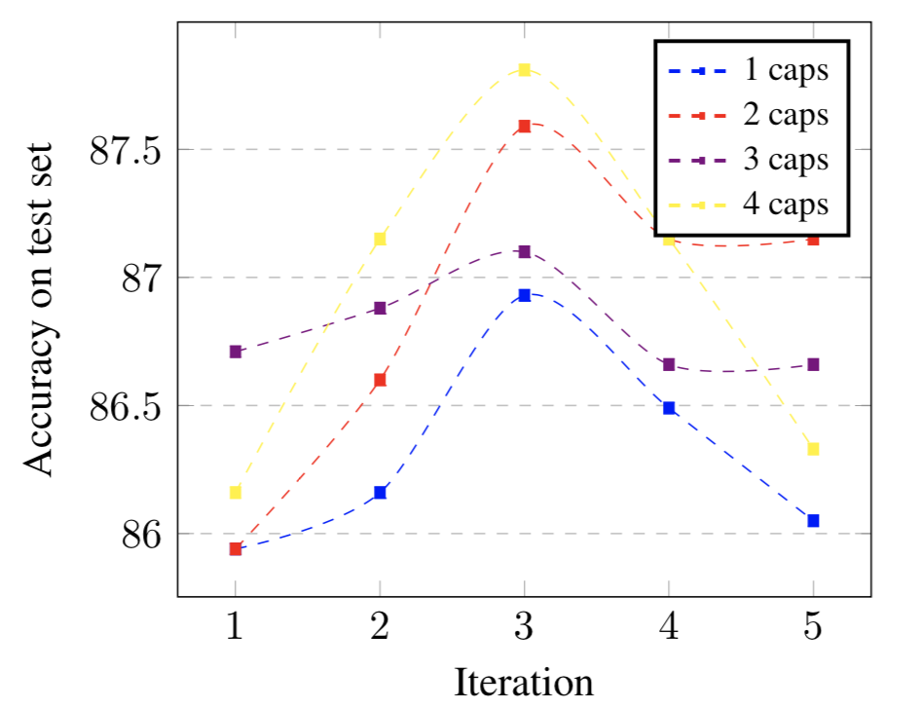
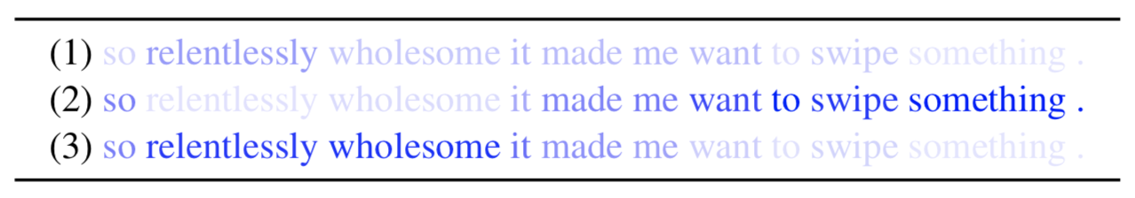
Experiment

Slide 9
Source
Dataset
https://pan.baidu.com/s/1x3lU9yrPNOYEpxqY_TtUbQ
src/data 폴더에 압축 해제
for sentence level datasets, more specifically for SST-1 and SST-2 datasets
python ./caps_attn_flatten/train_test.py --load-config --weight-path ./savings/sst01
python ./caps_attn_flatten/train_test.py --load-config --weight-path ./savings/sst02
for document level datasets, more specifically for imdb, yelp-2013 and yelp-2014
python ./caps_attn_hierarchical/train_test.py --load-config --weight-path ./savings/imdb
python ./caps_attn_hierarchical/train_test.py --load-config --weight-path ./savings/yelp201
python ./caps_attn_hierarchical/train_test.py --load-config --weight-path ./savings/yelp2014

